Slide 1
Computer Architecture
Lab 6

Slide 2
MIPS Instruction Set Architecture

Slide 3
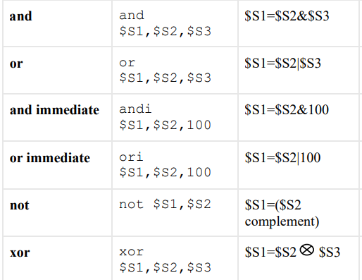
Logical Instructions

Slide 4
Even & Odd Numbers In Binary
Hexadecimal
8 2 1 F
F A C D
Even Number
Odd Number
Binary
1111101011001101
1011010011110100
Least Significant Bit
Least Significant Bit
0 = Even
1 = Odd
0 = Even
1 = Odd

Slide 5
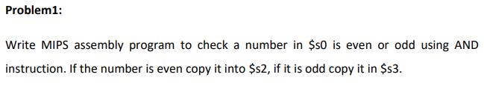
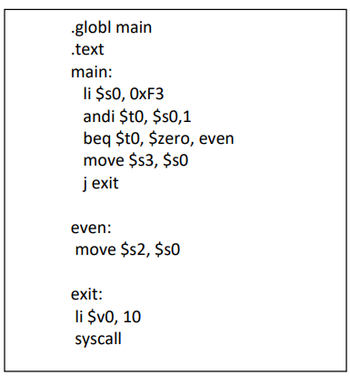
odd
even
1111 0011
1111 0010
0000 0001
0000 0001
0000 0001
0000 0000
t0=1
t0=0

Slide 6
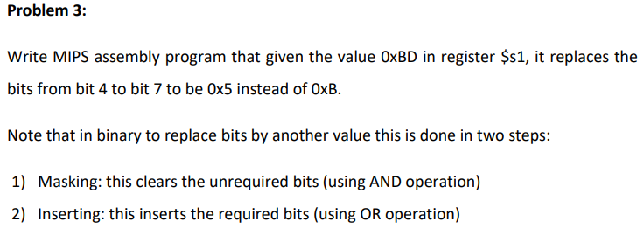
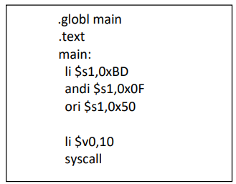
B D
1011 1101
0000 1111 and
0 F
----------------------
0000 1101
0101 0000 or
5 0
------------------------
0101 1101
5 D

Slide 7
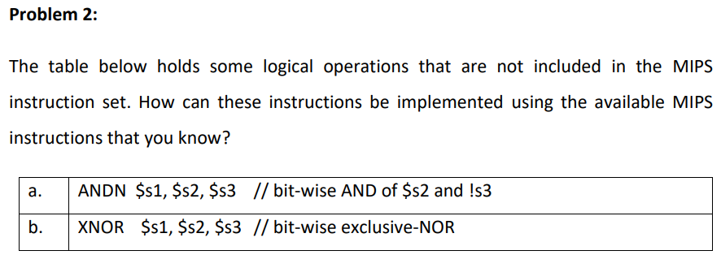
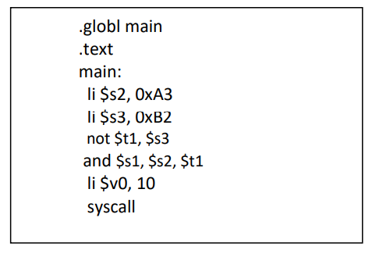
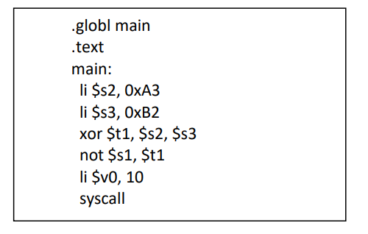

Slide 8
Shift
Micro-operations
Logical Shift left
Logical Shift right
Circulate left
Circulate right
Arithmetic Shift left
Arithmetic Shift right
Vs =0
0100
Example1
0010
0100
0101
0101
0010
0100
0010
1010
1010
0100
0010
Example2
1010
1100
1100
1100
1010
1100
0100
Vs =1
1110
0110
1001
0110
0100
1 Shift left → multiply by 2 with unsigned numbers
1 Shift right→ divide by 2 with unsigned numbers
Can not solve the problem, but indicates overflow

Slide 9
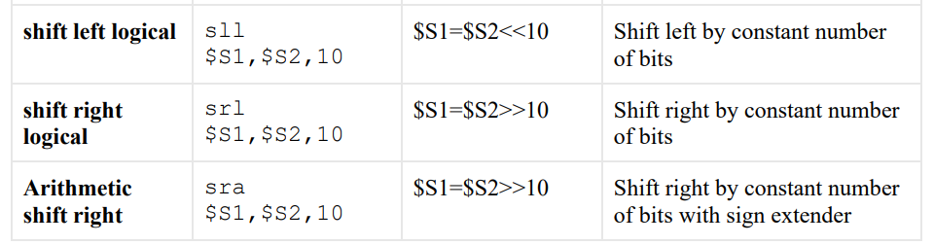
Shift Instructions
Notes:
All the shifting Instructions works with immediate value.

Slide 10
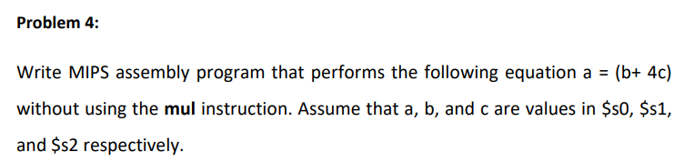
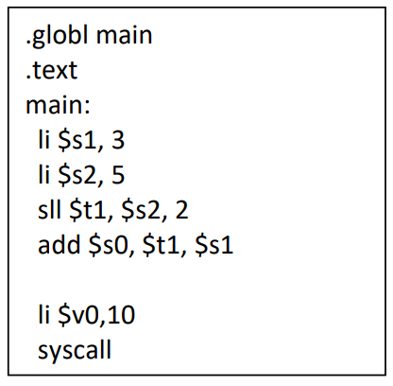

Slide 11
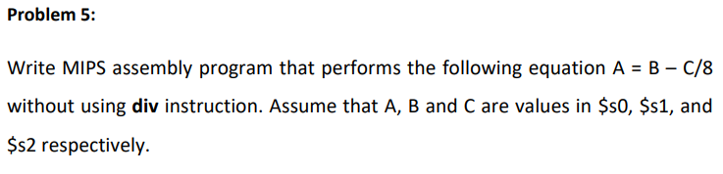
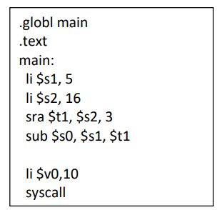

Slide 12
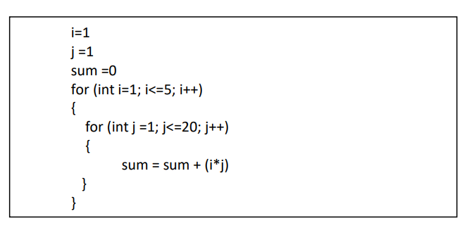
Problem 7

Slide 13
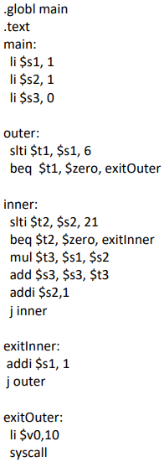
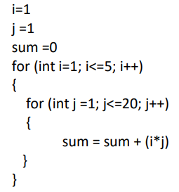
Problem 7
i
j
for (int i=1; i<=5; i++)
for (int j =1; j<=20; j++)
j++
i++

